Slide 1

Direct Lake & Tabular Editor
Explore and understand
Notes:
The new capabilities of Fabric and the features of Tabular Editor together will help you create effective datasets that enable users to make the most of their data.

Slide 2


About me
Morten Lønskov Product Manager
Works with feature planning, support, documentation, content etc.
Danish, but lives in Hamburg

Slide 3
Tabular Editor – the company
Founded in 2021
Develop and sell Tabular Editor 3
Customers in more than 100 countries
Part of Tabular Tools (with SQLBI)

Slide 4
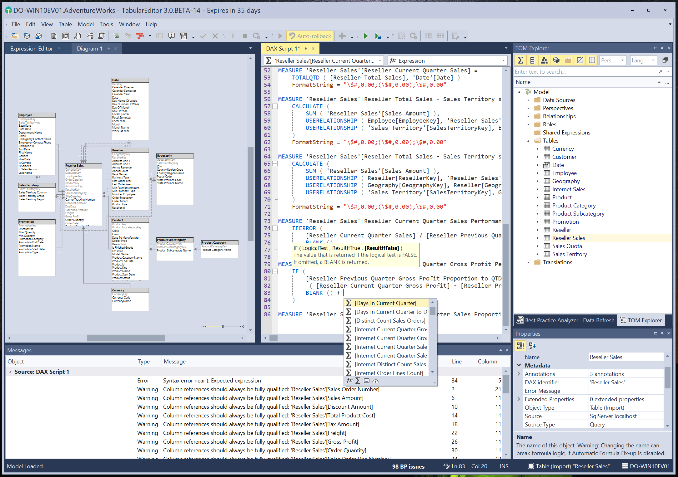
What is Tabular Editor 3
Evolution of the open-source Tabular Editor 2.x
Windows Desktop application
Brining semantic modeling to warp speed
Why commercial?
Premium features with years of investment
Dedicated team for development and support
Tabular Editor 2.x remains free and open-source

Slide 5

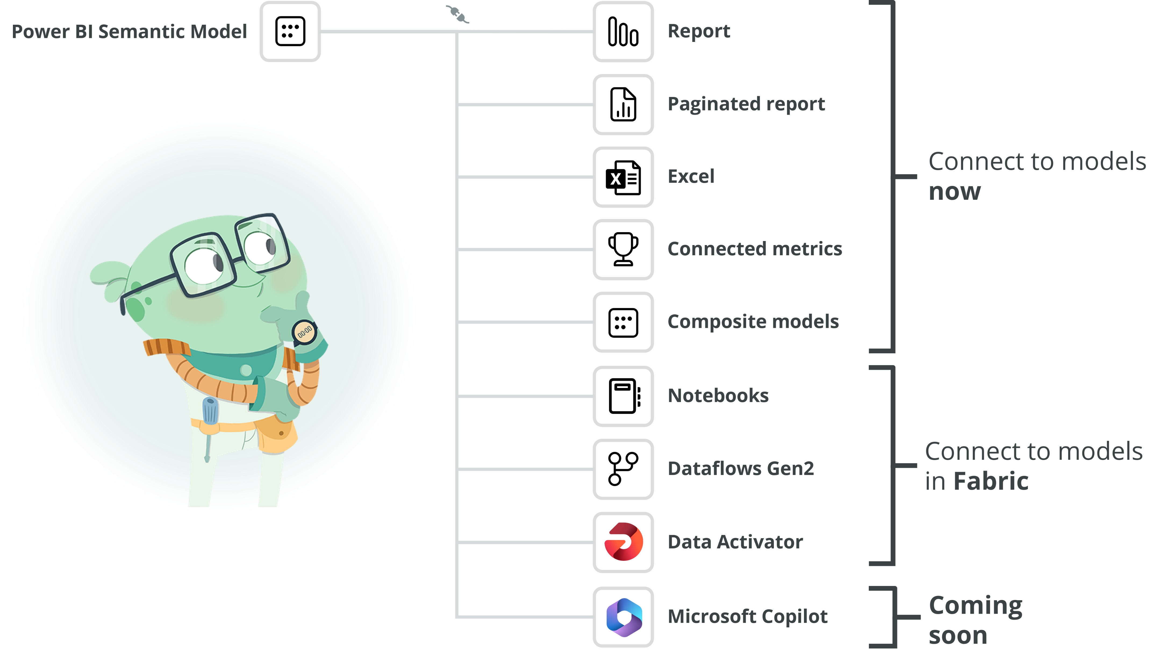
Semantic models will have more impact
More workloads and tools will connect to semantic models to enable users to solve business problems with data
Organizations need to develop and support both self-service and enterprise data models.
Requires robust, scalable tools and processes

Slide 6

Direct Lake: The new semantic model type
Promises the best of Import with the latency of DirectQuery
Created on top of OneLake
Queries SQL Endpoint of Fabric Lake House or Datawarehouse
No import of data into a model
Web-Authoring or External tool to create/edit
Notes:
What are Direct Lake: It is a new semantic model type, previously we had import, direct query, composite models
No need to import data in the last step of your etl, load it into your Lake house or warehouse and it is ready to be used.

Slide 7




Direct Lake model & Tabular Editor
OneLake
Direct Lake Model
Fabric Portal
Connect & Model
Notes:
In OneLake data is stored in delta parquet files that are creating with your Lake house or datawarehouse.
Direct Lake is a semantic model that is directly on top of the lake house or datawarehouse.
Basically, Microsoft has rewritten the Power BI engine (vertipaq) to use the open format of delta instead of a properity column store based.
But it is still a regular semantic model that does all the same things as an import mode.
So we still need to develop the model which is where Tabular Editor comes in

Slide 8
Direct Lake model: When is it one
Three criteria for a model to be a Direct Lake model
1. Compatibility Level is 1604 or higher.
2. The partitions mode must be Direct Lake
3. Partitions use a shared expression with SQL endpoint.
Source: Learn about Direct Lake in Power BI and Microsoft Fabric - Power BI | Microsoft Learn

Slide 9
DEMO
Creating a Direct Lake model and exploring properties
NOTE
Creating or editing a semantic model through XMLA endpoint locks it from web authoring.

Slide 10




Understanding Direct Lake models
Introduces new concepts
Framing instead of refresh
New properties in play
Performance metrics additions

Slide 11

Framing
I thought you said no more refreshing?
OneLake
Direct Lake Model
Fabric Portal
Notes:
Framing is the process of including newly added files to onelake in the Direct Lake model
Fabric automatically keeps this up to date, but it is a setting that can be disabled if needed

Slide 12
Framing
A new file is added to Lake house or Data Warehouse
OneLake
Direct Lake Model
Fabric Portal
Notes:
Framing is the process of including newly added files to onelake in the Direct Lake model
Fabric automatically keeps this up to date, but it is a setting that can be disabled if needed

Slide 13
Framing
The Direct Lake model needs to know that it is there
OneLake
Direct Lake Model
Fabric Portal
Sources: Exploring Direct Lake Framing and warm-up data using Semantic Link in Fabric Notebooks – Data – Marc (data-marc.com) What does it mean to refresh a Direct Lake Power BI dataset in Fabric? (crossjoin.co.uk)
Notes:
Framing is the process of including newly added files to onelake in the Direct Lake model
Fabric automatically keeps this up to date, but it is a setting that can be disabled if needed

Slide 14
Framing
The initial framing is also needed to ensure Direct Lake doesn’t only use Direct Query
If the model is created in Power BI web interface handles automatically
In Tabular Editor we need to frame before Direct Lake works.

Slide 15
DEMO
Framing

Slide 16
New Properties to know
Direct Lake Behavior
Optimization of Delta tables impacts performance
Collation

Slide 17
Direct Lake Behavior
Determines Direct Lake fallback behavior
DAX query fallbacks to DirectQuery if Direct Lake limitations are reached
Should you?
Pros: Always in DL mode, potential performance gains
Cons: Your visuals might now work
Source: Controlling Direct Lake Fallback Behavior (fabric.guru)
Notes:
Fall back occurs when: The number of files per table, row groups per table, number of rows per table, model size on disk are reached
Semantic model uses data warehouse views
RLS/OLS are defined in the data warehouse
Semantic model is published via XMLA endpoint and has not been reframed
See Microsoft ducomentation for DirectLake
Should you You will likely see performance gains. When the Direct Lake behavior is set to "Automatic", two query plans are generated - one for Direct Lake and another for DirectQuery.
Con: But is that bad, then you need to change your model to get the best our of DL, and not get asked about why the report is slow

Slide 18
Delta Tables
The way your Delta Tables are created and maintained will impact performance
spark OPTIMIZE is your friend
DataFlowsGen2 perhaps not
Limited documentation currently but a good source is fabric.guru
Notes:
Pay close attention to the Delta tables (#files, rowgroups, size etc.), as it will e.g. impact fallback as well as how well the Direct Lake performs well.
The spark Optimize is what helps bring the best performance
DataflowsGen2 seems to create one big parquet table which is suboptimal for Direct lake performance
You need to test and optimize your delta tables in Fabric to get the best performance on very big models.

Slide 19
Collation Property
Web UI models sets a collation
“Regular” import Power BI models does not have this property
Can lead to different ‘interpretations’ of data.
Specifically, around case sensitivity on columns
Depending on model collation, DQ and DL can give different results.

Slide 20
DEMO
Collation

Slide 21
Performance Metrics
Vertipaq Analyzer has new columns
Only apply to Direct Lake
Can help understand Direct Lake behavior

Slide 22
Pageable
Data can be evicted from the column to save memory when not in use
Resident
Data currently resides in the column
Temperature
A relative indication of how often data in this column is used to serve DAX queries
Last Accessed
The last time data in this column was used to serve a DAX query
Notes:
Pageable: The data can be fully evicted from memory if they are not used in queries.
Resident: The data has been framed by the model and exists in the cold cache
Temperature: a scaled number indicating often the data is accessed by DAX queries
Last Accessed: The last time the column was used

Slide 23
DEMO
Vertipaq Analyzer

Slide 24

Thank You
Q&A
learn.tabulareditor.com

Slide 25
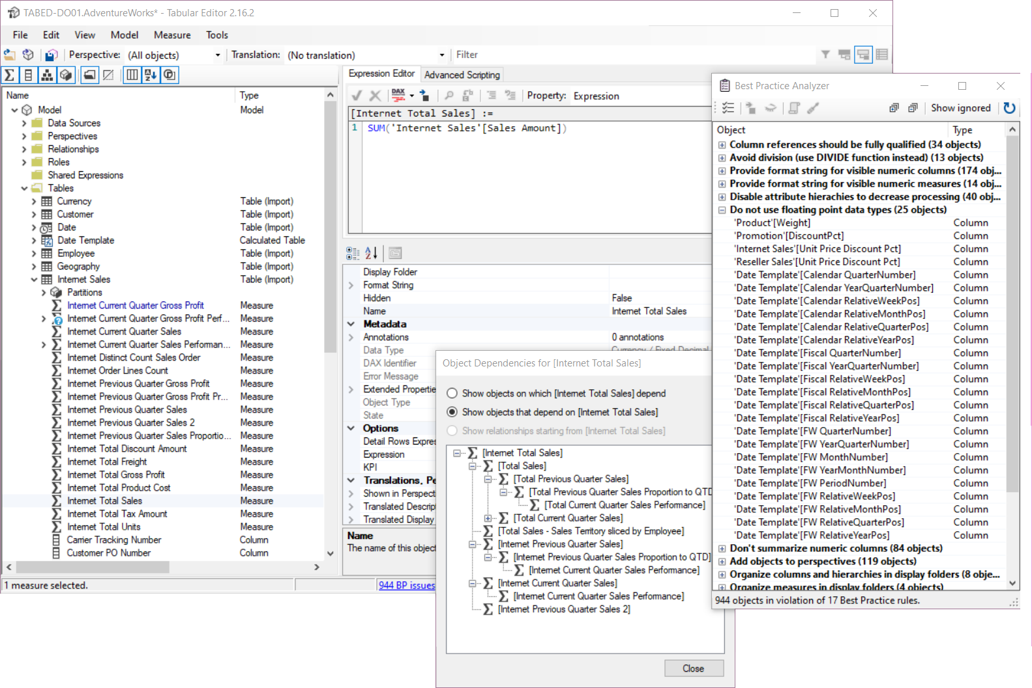
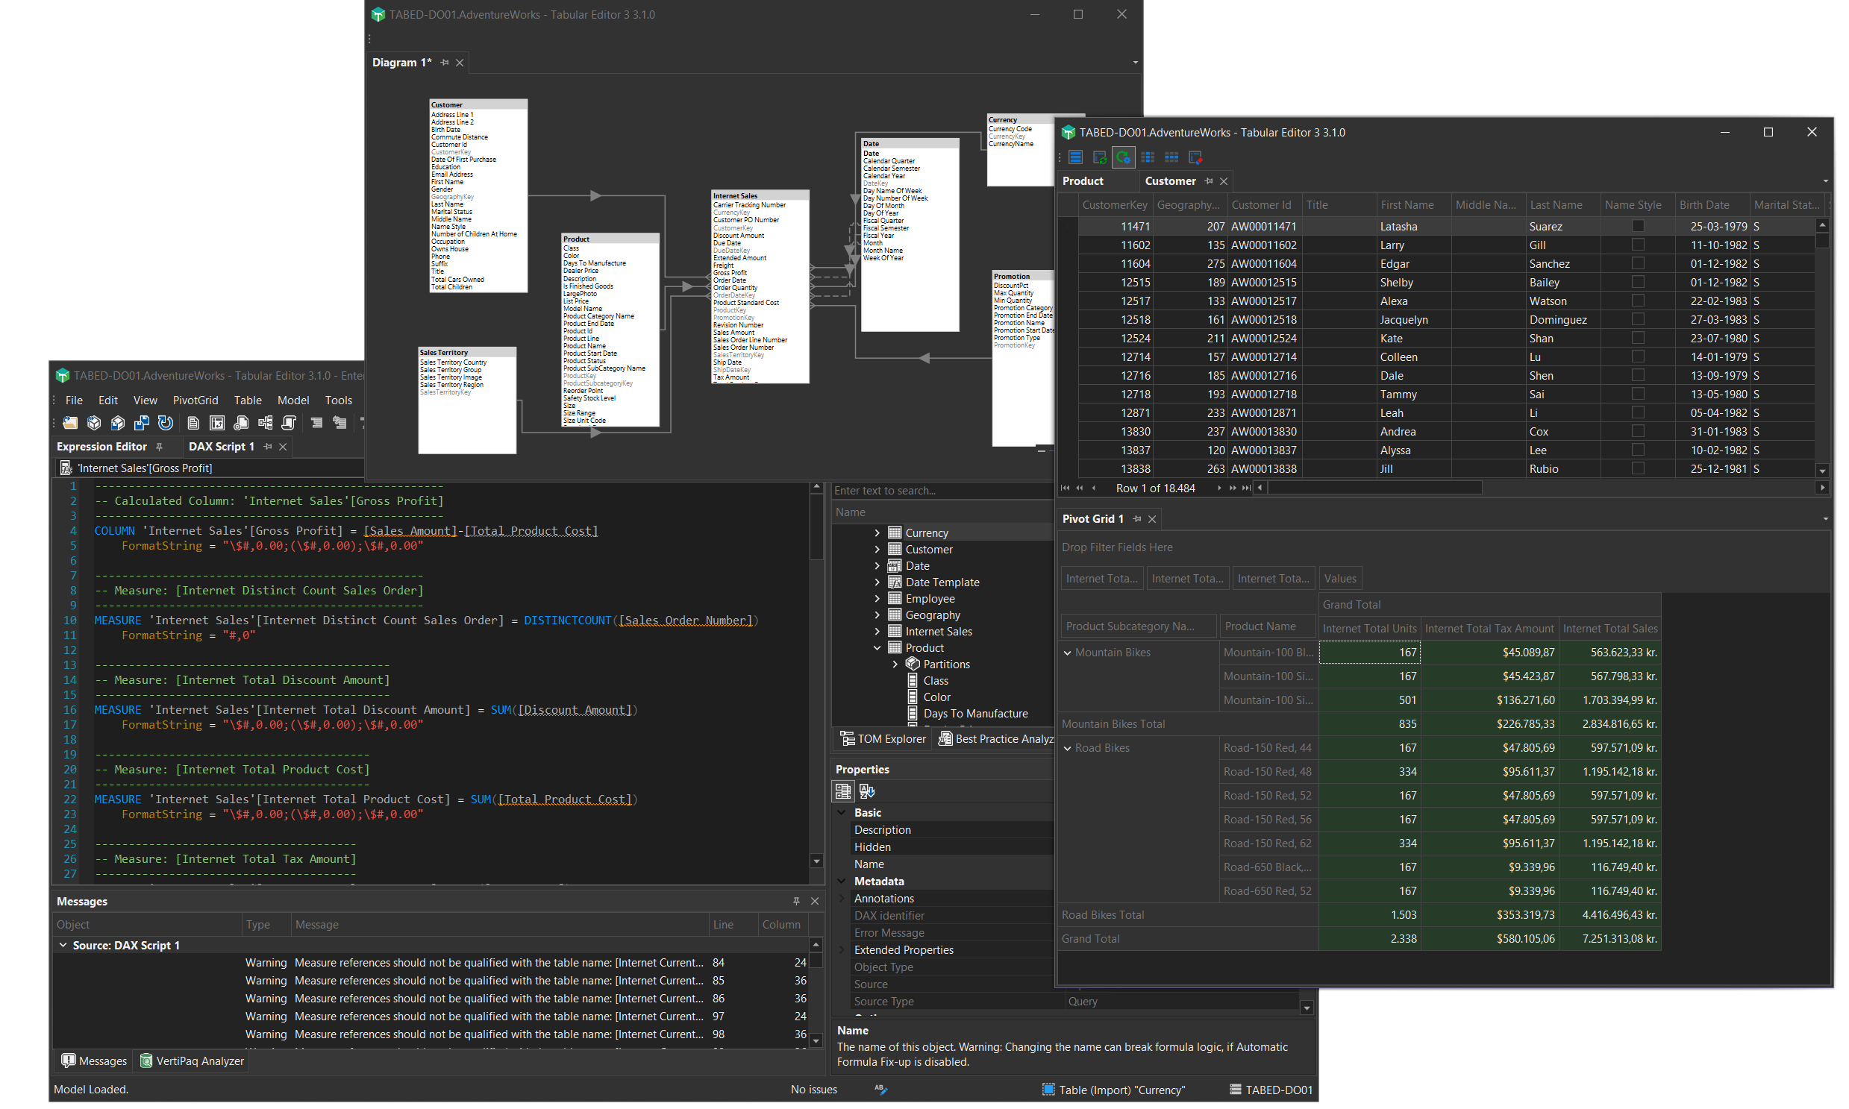
What is Tabular Editor 3
Evolution of the open-source Tabular Editor 2.x
Tabular Editor 2
Open source & free
Tabular Editor 3
Commercial product
Notes:
Daniel

Slide 26
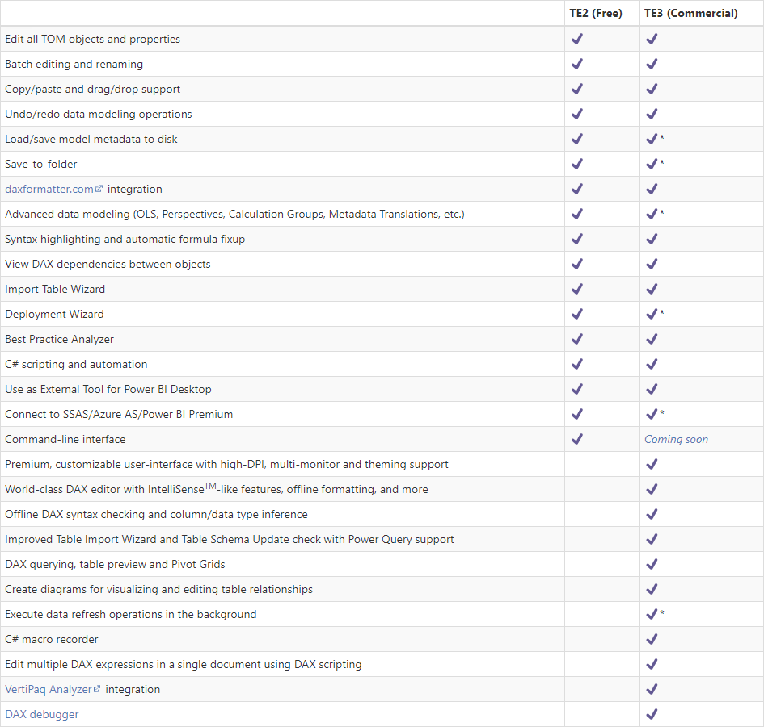
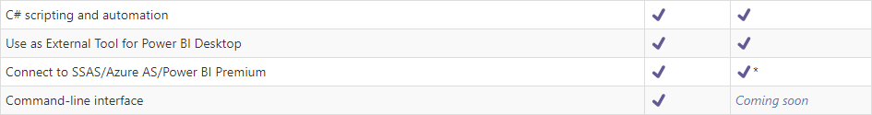
TE2 vs TE3
Notes:
Daniel There is a full feature list available on docs.tabulareditor.com, I don’t expect you to be able to read this.
I’ll highlight a few:
Batch editing and renaming – such a time saver – is available in both versions
Save to folder, which enables you to “explode” your model.bim into hundreds of files – which is the cornerstone of doing this with DevOps and CI/CD – is in both editions
C# scripting and automation is in both – you’ll get better help in TE3, but can achieve the same in both
Using as an external tool for PBI Desktop is the same – we’ll get back to that later
But now we get to some of the more advanced features, that is only in TE3
DAX Editor with intellisense, allowing you to be more productive when writing your DAX and have validation right there while writing
It also allows you to work offline and still be able to create calculated columns/tables etc.
In TE2 you only work on the datamodel, but in TE3 you get a fully connected development experience and can both see your data, query it, and even debug why your DAX measures isn’t giving the result you expect
We can use the integrated Vertipaq analyzer to see data cardinality and use that to warn about doing certain things with high cardinality columns
And finally we have the worlds only debugger for DAX code – more on that later.

Slide 27
Fabric relies even more on semantic models
Semantic models will have more impact in an organization
Semantic models will become more prevalent
Managing and supporting semantic models will become more complex
Notes:
Morten
There are three primary ways in which Fabric

Slide 28
Semantic models will become more prevalent
Auto-generated default models
Direct Lake models are easy to create for all users
Web Authoring of models
New Personas : Data scientist with semantic models
Notes:
Morten
Default datasets: Fabric items like Lakehouses, Data Warehouses and Datamarts generate default datasets. These datasets are created automatically so that you can quickly explore data with Power BI Reports, Notebooks or client tools. As more of these items are created, more default datasets will be produced. Managing these datasets will be important if they are used for downstream reporting or analytics.
Direct Lake datasets: The ease with which users can add data to OneLake and explore it with Direct Lake datasets – even from My Workspace – may lead to an increase in the prevalence of Personal BI and Prototyping Power BI usage scenarios. As more users store data in OneLake, more Power BI datasets will be created to explore and analyze this data.
Web authoring: Users can create and modify Power BI datasets from the browser by using the Power BI service. This opens dataset authoring to whole new populations of users who otherwise couldn’t use Power BI Desktop, before. Increasing the number of users who can author datasets will invariably lead to more datasets in general, over time.
New personas: With Notebooks, Data Scientists can easily connect to and leverage the business logic in Power BI datasets for their analyses and models. This is an entirely new user population that previously couldn’t easily connect to and benefit from datasets. Furthermore, these users can write their outputs back to OneLake, which can be immediately visible in Direct Lake datasets and connected reports. This native writeback functionality enables a number of exciting use-cases, such as simplifying implementation of basic predictive analytics in Power BI reporting.

Slide 29
Managing semantic model will be more complex
More options: Models with import, Direct Query, hybrid, and now Direct Lake storage mode.
More models created that will need support and optimization
AI-driven DAX in self-service scenarios
Notes:
Morten
More options: With Fabric, it’s now possible to have datasets with import, Direct Query, hybrid, and now Direct Lake storage mode. Each of these storage modes have their own use-cases and considerations. Managing these datasets will require a good understanding of their use-cases, considerations and limitations.
More datasets: As described in the previous section, Fabric will likely result in more datasets in an organization’s tenant. Supporting and managing these datasets requires robust tools and techniques. Programmatic management and optimization of datasets will be essential, for example by scanning datasets with the Best Practice Analyzer.
AI-driven DAX: Copilots and other generative AI tools will help self-service content creators write more sophisticated DAX expressions for measures, calculated columns and calculated tables. However, these AI tools will not be a replacement for core theoretical knowledge and critical thinking. Generative AI can produce code flawed in its performance or approach, as it will never perfectly understand or interpret the author’s intent and the full extent of their code’s use cases. Pro tools and mature methods will be needed to effectively debug these expressions and support these datasets.

Slide 30







Handle semantic models by using Tabular Editor
Enterprise BI
Models
Team/Dept. BI from Business Teams
Self-Service BI
Models
Service
Fabric or PPU
Connect & Analyze
Self-Service Power BI Desktop Analyses
Notes:
Morten

Slide 31




Tabular Editor helps you make better models, faster
Enhancing productivity
Work asynchronously offline
Make and test changes before writing them to the model so you don’t wait to see the result
Change many things at once
Batch tasks with the TOM Explorer or edit multiple DAX objects at once by using DAX scripts
Manage tables and columns
Add or remove objects and update schemas with UI wizards. Refresh selected tables asynchronously
DAX
Write better DAX, faster
Code assistance features guide you when writing DAX to save time and avoid mistakes
Automate development
Use C# scripts and macros to streamline or fully automate repetitive, multi-step tasks
Notes:
Daniel

Slide 32








Tabular Editor helps you make better models, faster
Improving data models
Detect errors and warnings
Messages alert to model issues so you can find and fix them before you deploy the model
Scan for best practice issues
Use the Best Practice Analyzer to automatically scan for and flag best practice rule violations
Validate while you work
Develop and test DAX more easily with a single window by using DAX queries and ‘Define measure’
Optimize data models
Reduce import model size with VertiPaq Analyzer, explore models with DAX queries and pivot grids
Debug DAX in less time/effort
Use the DAX debugger to break up DAX code into steps so you can fix and understand it, better
Notes:
Daniel

Slide 33






Tabular Editor helps you make better models, faster
Scaling enterprise models
Automate testing
Use the command-line interface to run C# scripts to evaluate DAX queries against known baselines
Automate deployment
Use the command-line interface to deploy models using the XMLA read/write endpoint
Set up and use source control
Save, manage and deploy model metadata in formats like TMDL to track object-level changes
Improve collaboration
Work on model metadata for easier merging of changes, while sharing common macros, BPA rules and layouts*
Notes:
Daniel

Slide 34
DEMO
NOTE
Creating or editing a semantic model through XMLA endpoint locks it from web authoring.

Slide 35
Thank You
learn.tabulareditor.com

Slide 36
DEMO: Connect to existing model Direct Lake
Create measures with scripts
Discourage implicit measures
How to optimize with BPA; Vertipac
Adding tables with Import wizard

Slide 37













Creating quality semantic models efficiently will be more important
More workloads and tools will connect to semantic models to enable users to solve business problems with data
Power BI Semantic Model
Report
Paginated report
Connect to models now
Excel
Connected metrics
Composite models
Notebooks
Connect to models in Fabric
Dataflows Gen2
Data Activator
Coming soon
Microsoft Copilot
Web authoring will produce more datasets from more self-service dataset creators
Generative AI will result in self-service semantic models having more complex DAX code
Many Fabric items generate semantic models automatically in the service
Direct Lake datasets will result in more semantic models created on OneLake sources

Slide 38
Tabular Editor helps you make better models, faster
Enhance productivity
Improve data models
Scale enterprise models
Work asynchronously offline
Make and test changes before writing them to the model so you don’t wait to see the result
Detect errors and warnings*
Messages alert to model issues so you can find and fix them before you deploy the model
Automate testing
Use the command-line interface to run C# scripts to evaluate DAX queries against known baselines
Change many things at once
Batch tasks with the TOM Explorer or edit multiple DAX objects at once by using DAX scripts
Scan for best practice issues
Use the Best Practice Analyzer to automatically scan for and flag best practice rule violations
Automate deployment
Use the command-line interface to deploy models using the XMLA read/write endpoint
Manage tables and columns
Add or remove objects and update schemas with UI wizards. Refresh selected tables asynchronously
Validate while you work*
Develop and test DAX more easily with a single window by using DAX queries and ‘Define measure’
Set up and use source control
Save, manage and deploy model metadata in formats like TMDL to track object-level changes
DAX
Write better DAX, faster*
Code assistance features guide you when writing DAX to save time and avoid mistakes
Optimize data models*
Reduce import model size with VertiPaq Analyzer, explore models with DAX queries and pivot grids
Improve collaboration
Work on model metadata for easier merging of changes, while sharing common macros, BPA rules and layouts*
Automate development
Use C# scripts and macros to streamline or fully automate repetitive, multi-step tasks
Debug DAX in less time/effort*
Use the DAX debugger to break up DAX code into steps so you can fix and understand it, better
Items marked with * require the use of Tabular Editor 3

Slide 39





More benefits from Tabular Editor with new Power BI features
More possibilities with Power BI Desktop
More possibilities with source control
Toward the future…
Less unsupported operations
Advancements in Desktop Hardening are making it possible to modify the entire TOM
.tmd
TMDL format (preview)
Use the new metadata format in Tabular Editor to more easily view and manage changes to models
Direct Lake models**
In the future, you could manage Direct Lake models entirely with Tabular Editor
Power BI Pro benefits
Use Tabular Editor to develop semantic models open in Power BI Desktop then publish to Pro shared capacity
Fabric Git integration
Benefit from workspace Git integration while working with remote models
Fabric data sources
Connect to SQL Endpoints to easily load Fabric data sources to import models, where needed.
Developer mode (.pbip); preview
Fully supported “Power BI Project’ mode with metadata management; no more download to .pbix restrictions if you can download to .pbip
Items marked with ** are not yet available in Fabric preview

Slide 40
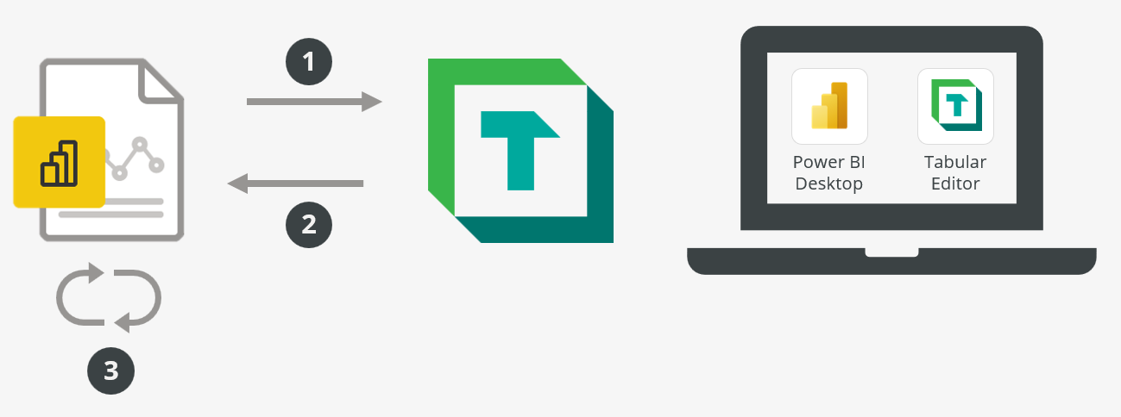
Using Tabular Editor with Power BI Desktop

Slide 41

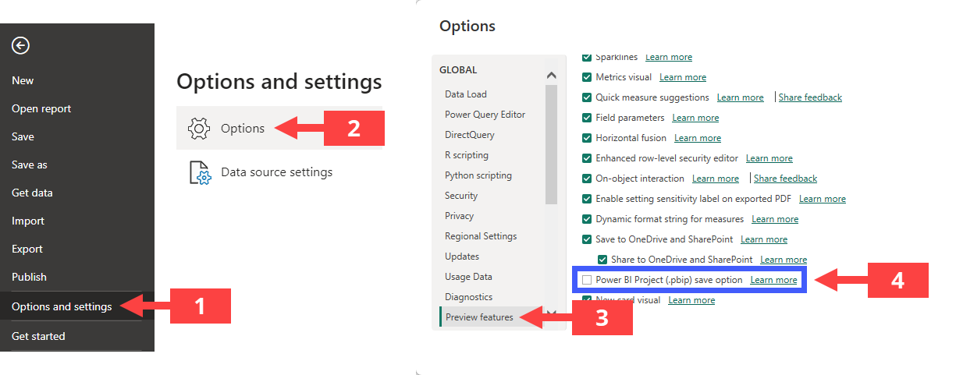
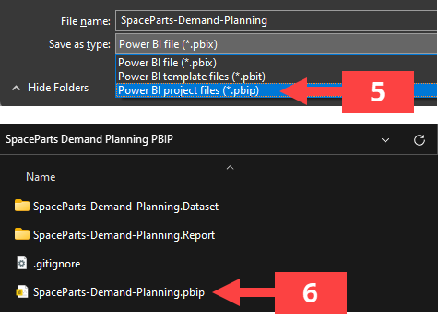

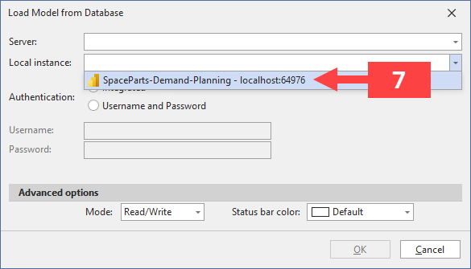
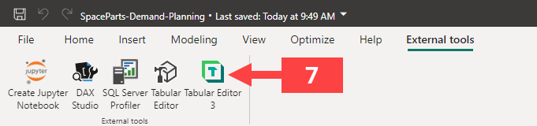

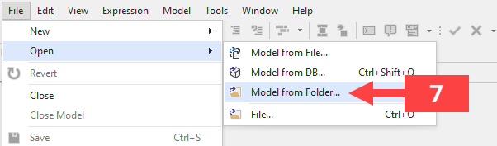
Enable and connect to Power BI project files (.pbip)
Enable .pbip from preview features, then save and open your first .pbip file in Power BI Desktop
TIP FOR #5
Create first a new folder in which you will save your .pbip that has the model name and suffix PBIP. This helps you organize the files this format produces.
Connect to the .pbip model open in Power BI Desktop or open the .pbip metadata in Tabular Editor
OR
OR

Slide 42
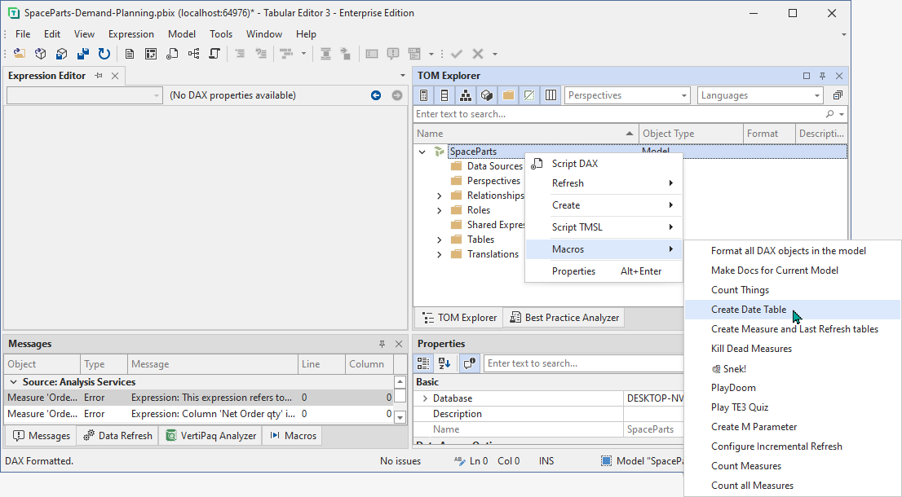












Develop and deploy Power BI project files (.pbip)
Work in Tabular Editor using DAX code assistance features, C# scripts/macros, queries, etc.
8
9
Deploy the semantic model with Power BI Desktop or Tabular Editor
Power BI Pro
shared capacity
Power BI PPU
shared capacity
Fabric and Azure DevOps
dedicated capacity (with workspace Git integration)
PUBLISH
PUBLISH
PUBLISH
COMMIT
A
A
A
Remote
DEPLOY
DEPLOY
XMLA Endpoint
XMLA Endpoint
COMMIT
B
B
QUERY
QUERY
Remote
C
SAVE
D
SAVE
COMMIT
TMDL
Local
Local
Remote
COMMIT
SYNC
DEPLOY
Remote
TIP FOR #9B
With Fabric Git integration, you can write changes to a remote model, then batch and commit those changes in the Fabric workspace. This can be a simpler way of doing source control for some teams.

